Slide 1
Graph Augmentation for GNNs

Slide 2
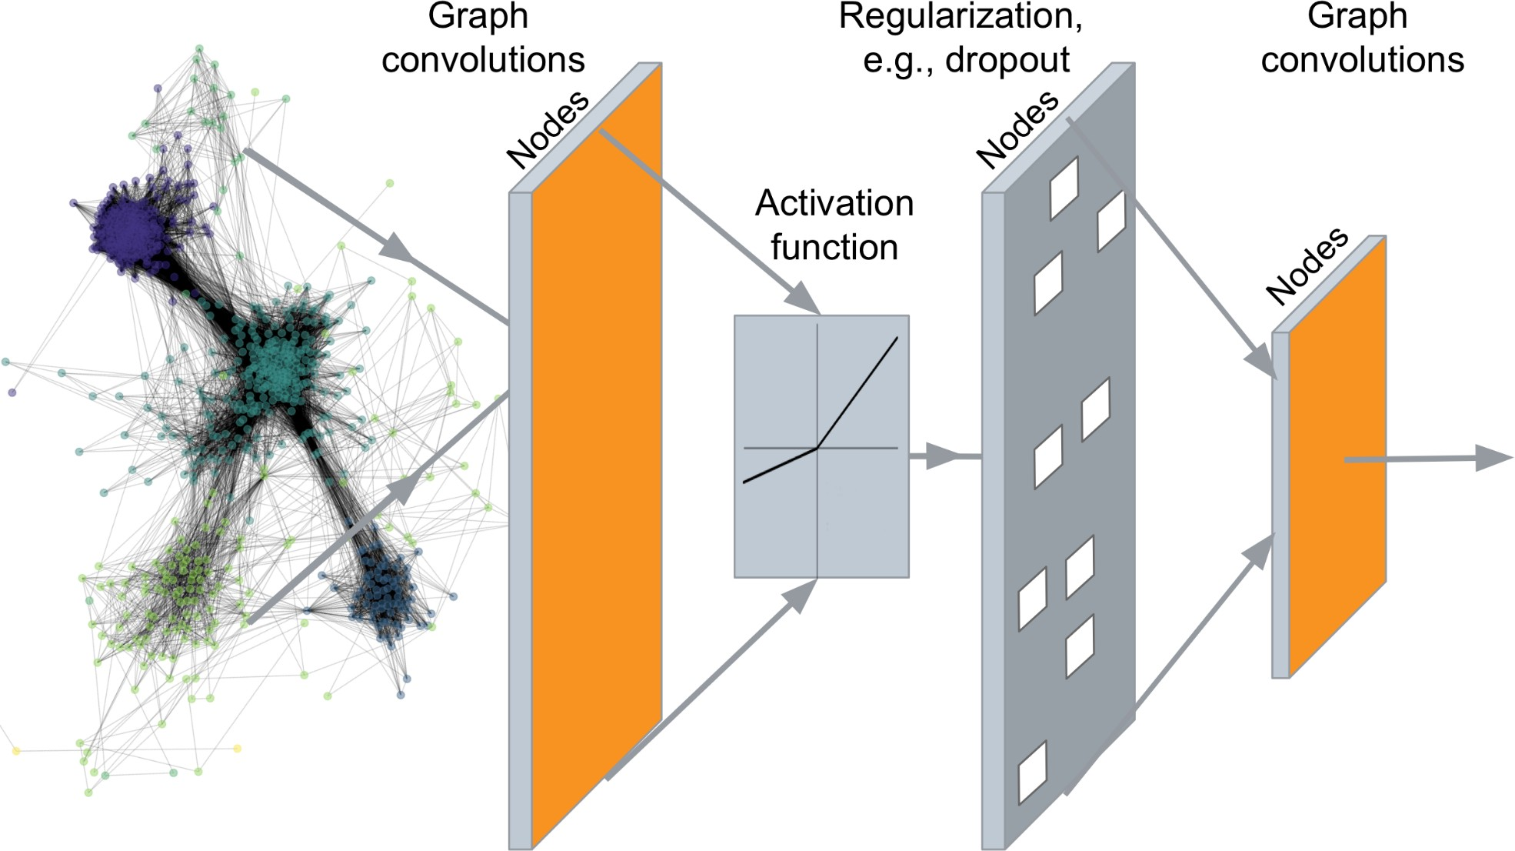
…
Output: Node embeddings. Also, we can embed subgraphs and entire graphs
2

Slide 3




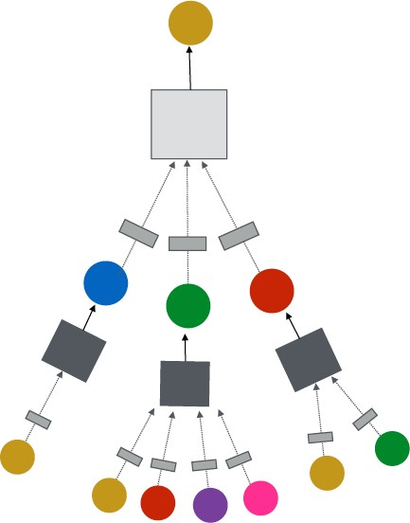


J. You, R. Ying, J. Leskovec. Design Space of Graph Neural Networks, NeurIPS 2020
TARGET NODE
B
(5) Learning objective
A
C
D
E
F
INPUT GRAPH
(2) Aggregation
(1) Message
GNN Layer 1
(3) Layer connectivity
GNN Layer 2
(4) Graph augmentation
3

Slide 4
Idea: Raw input graph ≠ computational graph
J. You, R. Ying, J. Leskovec. Design Space of Graph Neural Networks, NeurIPS 2020
TARGET NODE
B
Graph feature augmentation
Graph structure augmentation
A
C
D
E
INPUT GRAPH
F
(4) Graph augmentation
4

Slide 5

Our assumption so far has been
Raw input graph = computational graph Reasons for breaking this assumption
Features:
The input graph lacks features
Graph structure:
The graph is too sparse → inefficient message passing
The graph is too dense → message passing is too costly
The graph is too large → cannot fit the computational graph into a GPU
It’s unlikely that the input graph happens to be the optimal computation graph for embeddings
5

Slide 6
Graph Feature augmentation
The input graph lacks features → feature augmentation
Graph Structure augmentation
The graph is too sparse → Add virtual nodes / edges
The graph is too dense → Sample neighbors when doing message passing
The graph is too large → Sample subgraphs to compute embeddings
Will cover later in lecture: Scaling up GNNs
6

Slide 7
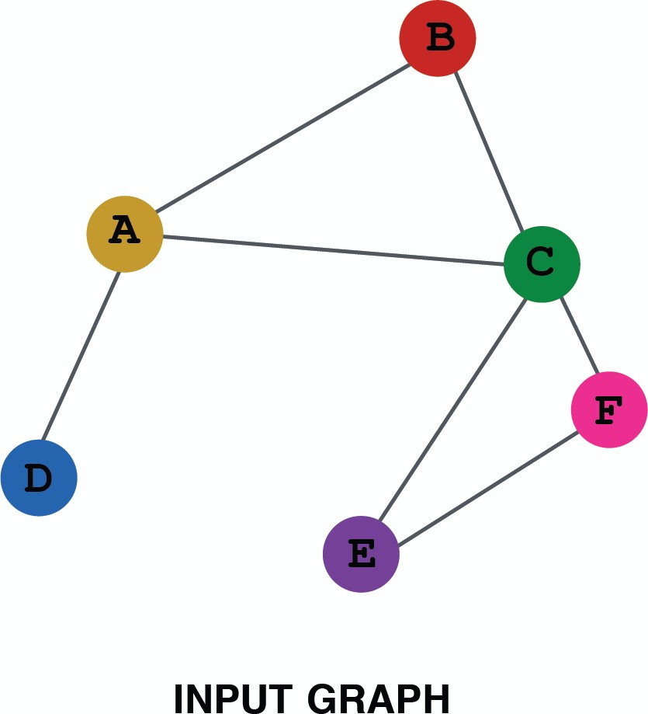
When might we need feature augmentation?
(1) Input graph does not have node features
This is common when we only have the adj. matrix
Standard approaches:
a) Assign constant values to nodes
1
1
1
1
1
1
7

Slide 8
When might we need feature augmentation?
(1) Input graph does not have node features
This is common when we only have the adj. matrix
Standard approaches:
b) Assign unique IDs to nodes
These IDs are converted into one-hot vectors
2
One-hot vector for node with ID=5
1
3
ID = 5
6
[0, 0, 0, 0, 1, 0]
Total number of IDs = 6
4
5
8

Slide 9
Feature augmentation: constant vs. one-hot
 | Constant node feature 1 1 ₁ ₁ 1 1 | One-hot node feature 2 1 ₃ ₄ 6 5
Expressive power | Medium. All the nodes are identical, but GNN can still learn from the graph structure | High. Each node has a unique ID, so node-specific information can be stored
Inductive learning (Generalize to unseen nodes) | High. Simple to generalize to new nodes: we assign constant feature to them, then apply our GNN | Low. Cannot generalize to new nodes: new nodes introduce new IDs, GNN doesn’t know how to embed unseen IDs
Computational cost | Low. Only 1 dimensional feature | High. 𝑂 𝑉 dimensional feature, cannot apply to large graphs
Use cases | Any graph, inductive settings (generalize to new nodes) | Small graph, transductive settings (no new nodes)
9

Slide 10
J. You, J. Gomes-Selman, R. Ying, J. Leskovec. Identity-aware Graph Neural Networks, AAAI 2021
When might we need feature augmentation?
(2) Certain structures are hard to learn by GNN
Example: Cycle count feature:
Can GNN learn the length of a cycle that 𝑣₁ resides in?
Unfortunately, no
𝑣₁ resides in a cycle with length 3
𝑣₁
𝑣₁ resides in a cycle with length 4
𝑣₁
10

Slide 11
𝒗_{𝟏} cannot differentiate which graph it resides in
Because all the nodes in the graph have degree of 2
The computational graphs will be the same binary tree
𝑣! resides in a cycle with length 3
𝑣! resides in a cycle with length 4
The computational graphs for node 𝒗_{𝟏} are always the same
𝒗_{𝟏}
𝒗₁
𝒗₂
𝑣! resides in a cycle with infinite length
…
…
𝒗₁
…
More about this topic later!
11

Slide 12
When might we need feature augmentation?
(2) Certain structures are hard to learn by GNN
Solution:
We can use cycle count as augmented node features
Augmented node feature for 𝒗_{𝟏}
[0, 0, 0, 1, 0, 0]
Augmented node feature for 𝒗_{𝟏}
[0, 0, 0, 0, 1, 0]
We start
from cycle
with length 0
𝑣₁ resides in a cycle with length 3
𝑣₁
𝑣₁ resides in a cycle with length 4
𝑣₁
12

Slide 13
Why do we need feature augmentation?
(2) Certain structures are hard to learn by GNN
Other commonly used augmented features:
Node degree
Clustering coefficient
PageRank
Centrality
…
13

Slide 14












Motivation: Augment sparse graphs
(1) Add virtual edges
Common approach: Connect 2-hop neighbors via virtual edges
Intuition: Instead of using adj. matrix 𝐴 for GNN computation, use 𝐴 + 𝐴²
Authors Papers
Use cases: Bipartite graphs
Author-to-papers (they authored)
2-hop virtual edges make an author-author collaboration graph
A
B
C
D
E

Slide 15
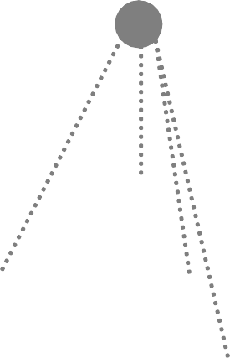
Motivation: Augment sparse graphs
(2) Add virtual nodes
The virtual node will connect to all the nodes in the graph
Suppose in a sparse graph, two nodes have shortest path distance of 10
After adding the virtual node, all the nodes will have a distance of two
Node A – Virtual node – Node B
Benefits: Greatly improves message passing in sparse graphs
The virtual node

Slide 16







Hamilton et al. Inductive Representation Learning on Large Graphs, NeurIPS 2017
Previously:
All the nodes are used for message passing
A
TARGET NODE
B B
C
A
B
A
C
A
C
F
E
D
F
E
D
INPUT GRAPH
A
New idea: (Randomly) sample a node’s neighborhood for message passing

Slide 17
For example, we can randomly choose 2 neighbors to pass messages in a given layer
Only nodes 𝐵 and 𝐷 will pass messages to 𝐴
A
TARGET NODE
B
B
C
A
B
A
C
A
C
F
E
D
E
D
INPUT GRAPH
A

Slide 18
In the next layer when we compute the embeddings, we can sample different neighbors
Only nodes 𝐶 and 𝐷 will pass messages to 𝐴
TARGET NODE
B
A
C
F
D
E
INPUT GRAPH

Slide 19
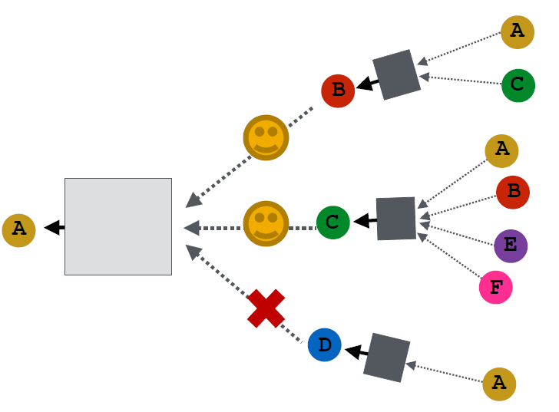
Ying et al. Graph Convolutional Neural Networks for Web-Scale Recommender Systems, KDD 2018
In expectation, we get embeddings similar to the case where all the neighbors are used
Benefits: Greatly reduces computational cost
Allows for scaling to large graphs (more about this later)
And in practice it works great!
TARGET NODE
A
C
F
D
E
INPUT GRAPH
20

